Slide 1
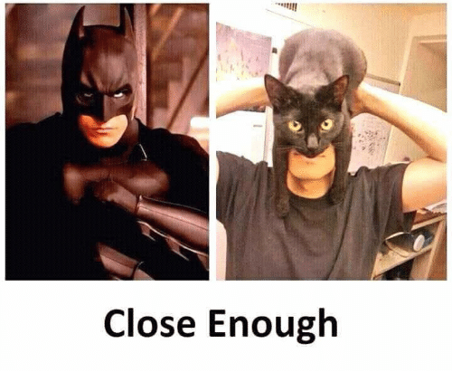
Rounding Decimal Numbers
Sometimes close enough is good enough!

Slide 2
24
7
30
Date
Topic: Number
EQ – How do you round to a specific number of decimal places?
5

Slide 3
BUT FIRST…
Let’s review what we did last lesson.
Turn to the last set of notes we did.
You have 1 minute 57 seconds to talk to your shoulder partner about what we did.
Let’s brainstorm…
Are your notes complete? Do you need to add anything? Add extra information in a different colour.
Do you have a summary?
No? let’s make one together…

Slide 4
BUT FIRST…
Let’s use a GIST summary technique…
If you ‘get the gist’ it means you get the idea and know what’s happening and why it works.
From our brainstorm, which are the 10 most important WORDS.
Let’s come up with a sentence or two together that uses most of these words.
Write it down.
Add the topic and EQ to your contents page.

Slide 5
Molly has $16 in her pocket
She buys:
3 hotdogs @ $1.89 each
3 milkshakes @ $2.19 each
3 Large French fries @ $ $1.79 each
Does she have enough money?

Slide 6
The rounding poem
Find your number
Look next door
4 or less, just ignore
5 or more add one more!

Slide 7
Rounding to 1 Decimal Place (1dp)
4 . 8 3 2 5
4 . 8 4 2 5
4 . 8 5 2
5 or more?
5 or more?
5 or more?
No
No
Yes
4 . 8
4 . 8
4 . 9
4 . 8 7
5 . 2 6 7 1 4
1 . 9 6 7
5 or more?
5 or more?
5 or more?
Yes
Yes
Yes
4 . 9
5 . 3
2 . 0

Slide 8
Rounding to Decimal Places: 2dp
4 . 8 3 2 5
4 . 8 4 6
4 . 8 5 9 5 1
5 or more?
5 or more?
5 or more?
No
Yes
Yes
4 . 8 3
4 . 8 5
4 . 8 6
1 . 6 9 4 9
5 . 2 6 7 1
1 . 8 9 7
5 or more?
5 or more?
5 or more?
No
Yes
Yes
1 . 6 9
5 . 2 7
1 . 9 0

Slide 9
Rounding to Decimal Places: 3dp
4 . 8 3 2 5
4 . 8 4 6 2
4 . 8 5 9 5
5 or more?
5 or more?
5 or more?
Yes
No
Yes
4 . 8 3 3
4 . 8 4 6
4 . 8 6 0
1 . 6 9 4 2
5 . 2 6 2 7
1 . 9 9 9 9
5 or more?
5 or more?
5 or more?
No
Yes
Yes
1 . 6 9 4
5 . 2 6 3
2 . 0 0 0

Slide 10
Rounding to Decimal Places
4 . 8 5 2
1dp
2dp
3dp
1 . 6 9 4 9
5 . 2 6 2 7
5 or more?
5 or more?
5 or more?
Yes
No
Yes
4 . 9
1 . 6 9
5 . 2 6 3
complete
this table:
Number | To 1DP | To 2DP | To 3DP
63.4721
87.6564
149.9875
3.54029
0.59999
63.5
63.47
63.472
Your Turn
87.7
87.66
87.656
150.0
149.99
149.988
3.5
3.54
3.540
0.6
0.60
0.600

Slide 11
Remember
If you are asked to round to the nearest tenth (or to 1 dp)…….your answer stops at the tenths place!
Example: Round 42.73 to the closest tenth would be 42.7

Slide 12
Special Case!
Rounding a 9
Round 2.197 to the closes hundredths
Since there is a “9” in the hundredths place consider the tenth and hundredths together – 19 – do you leave it at 19 or move it to 20?

Slide 13
Round 4.95 to the closest tenth
Since there is a “9” in the tenth spot consider the ones and tenths together…… should you leave it at 49 or move it to 50?
4.95 rounded to the nearest tenth is 5.0

